Slide 1

Running and Maintaining the Rwanda CGE Model
Designing, interpreting and presenting simulations Unpacking and updating SAMs
Adding model features
MINECOFIN SAM-CGE Training Workshop 6 | June 13-17, 2022

Slide 2
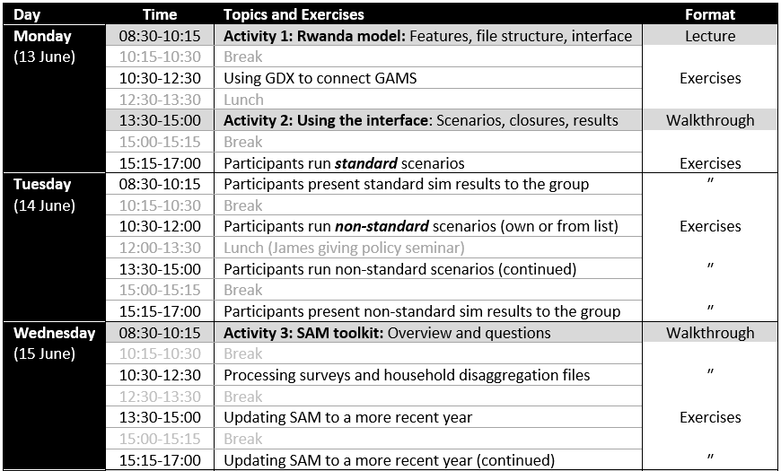
Week’s Agenda (1)

Slide 3
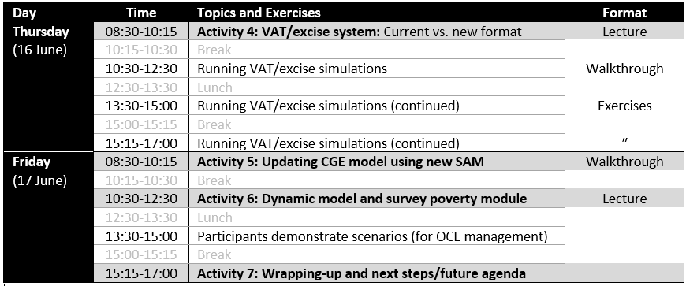
Week’s Agenda (2)

Slide 4
Activity 1.1 Rwanda CGE Model and Excel Interface General equilibrium features Factor and macro closures

Slide 5
Economywide General Equilibrium Framework
CGE models capture all economic linkages in the SAM
Drop the assumption that resources are unconstrained
Product prices
Factor prices (labor wages, land rents, capital profits)
Exchange rate
Maintain macroeconomic & resource balances
Government (fiscal accounts)
Investment & savings
Rest of world (current account)
Factor markets
Consistent framework for tracking economywide impacts
Macro-accounting principles are respected
Macro and micro feedbacks are tracked
Activities (producers)
Agriculture
Industry
Services
…
Investments & subsidies
Regional
Trade
Factor markets
Product markets
Rest of world
Aid
Regional
National
Taxes
Government
Households (consumers)
Regional migration & remittances
Rural
poor
Rural
nonpoor
Social transfers
Urban
poor
Urban
nonpoor
Regional

Slide 6
Supply Chains | Activity Output
Basic SAM layout
WAREHOUSE
 | A | C | F | D | W | TOT
A
C
F
D
W
TOT
Activities vs. commodities
Some activities produce more than one commodity
Main commodity: Beef
By-product: Leather
Aggregate activity output
Final output is a combination (composite) of factor and intermediate inputs
No substitution
FACTORY
A = Activities
C = Commodities
F = Factors
D = Final demanders
W = Rest of world
Activity gross output
Production function
Producers can substitute between factors when relative factor prices change
Intermediate demand
Producers require inputs in fixed proportions and cannot substitute even if prices change
No substitution?
Value-added
Intermediates
Substitution (CES)
No substitution (Leontief)
Labor
Land
Capital
Feed
Medicine
Other

Slide 7
Supply Chains | Commodity Supply & Demand
MARKET
Basic SAM layout
 | A | C | F | D | W | TOT
A
C
F
D
W
TOT
Households
Government
Investment
Intermediates
Fixed exp. shares (LES)
No substitution (Leontief)
No substitution
No substitution
Total demand
Total supply
Composite commodity
A = Activities
C = Commodities
F = Factors
D = Final demanders
W = Rest of world
Import demand function
Substitution (CES)
Export supply function
Imports
Domestic sales
Exports
Output aggregation function
Combines commodities from different activities & allows substitution to ensure lowest composite price
WAREHOUSE
Substitution (CET)
Aggregate commodity output
Substitution (CES)
Main activity: Leather
Second activity: Livestock

Slide 8
Product Market Equilibrium
 | A | C | F | D | W | TOT
A
C
F
D
W
TOT
A = Activities
C = Commodities
F = Factors
D = Final demand
W = Rest of world
Equilibrium: Total commodity supply must equal total demand
(mediated by prices changes)
Factory
Activities combine factor and intermediate inputs to produce activity output
Warehouse
Warehouse sorts outputs from activities into bundles of like commodities
Trade
Commodity output is traded in export or domestic markets – latter is combined with imports
Market
Composite supply is either sold to final demanders or to producers as inputs
Labor
Land
Value-added
Imports
×
×
=
Households
Capital
Activity output
Commodity output
Domestic sales
Composite supply
Government
=
=
Input 1
×
=
Investment
Input 2
Intermediates
Main output
Exports
=
=
Intermediate
Input N
By-product
×
× Price-driven substitution
= No substitution
Others’ output

Slide 9
Institutions | Incomes & Spending
Government closure rule to main balanced budget
Raise taxes?
Foreign closure rule to balance current account
Increase foreign inflows?
Investment closure rule to match savings
Increase savings rates?
Reduce investment spending?
Borrow more? (save less)
Adjust exchange rate to alter trade flows?
Reduce consumption?
Basic SAM layout
Households
Government
Investment
World
 | A | C | F | H | G | I | W | TOT
A
C
F
H
G
I
W
TOT
Factor earnings
Direct taxes
Private savings
Exports
+
+
+
+
Total income
Transfers
Indirect taxes
Public savings
Grants + Remit.
+
+
+
+
Remittances
Grants
Foreign savings
Foreign savings
A = Activities
C = Commodities
F = Factors
H = Households
G = Government
I = Investment
W = Rest of world
=
=
=
=
Consumption
Consumption
Consumption
Imports
+
+
Total spending
Direct taxes
Transfers
+
+
Savings
Savings

Slide 10
Macroeconomic Balances
 | A | C | F | H | G | I | W | TOT
A
C
F
H
G
I
W
TOT
A = Activities
C = Commodities
F = Factors
H = Households
G = Government
I = Investment
W = Rest of world
Equilibrium: Total receipts must equal total expenditures
(determined by “closure rules”)
Government
Recurrent fiscal deficit (savings) equals total revenues (taxes and grants) less total expenditures (consumption and transfers)
Fix two
Tax rates
Consumption
Public savings
Direct taxes
+
Indirect taxes
+
Grants
=
Consumption
+
Transfers
+
Public saving
Current account
Total inflow of foreign exchange (exports, grants and remittances) must equal total outflows (imports)
Fix one
Exchange rate
Foreign savings
Exports
+
Grants
+
Remittances
+
Foreign saving
=
Imports
Savings – Investment
Total supply of loanable funds (savings) must equal total investment demand
Fix one
Private savings rates
Investment
Private saving
+
Public saving
+
Foreign saving
=
Investment

Slide 11
Factor Market Equilibrium
 | A | C | F | D | W | TOT
A
C
F
D
W
TOT
A = Activities
C = Commodities
F = Factors
D = Final demand
W = Rest of world
Equilibrium: Total factor supply must equal sum of sectoral factor demand (determined by “closure rules”)
Factory
Workforce
=
Labor
+
Labor
+
Labor
Fix one
Economywide wage
Total factor supply
Land availability
=
Land
+
Land
+
Land
Value-added
×
Capital supply
=
Capital
+
Capital
+
Capital
× Price-driven substitution
Wages
Wages
Option 1
Full employment
Option 2
Unemployment
Employment
Employment

Slide 12
Activity 1.2 Rwanda CGE Model and Excel Interface Model file structure and Interface

Slide 13
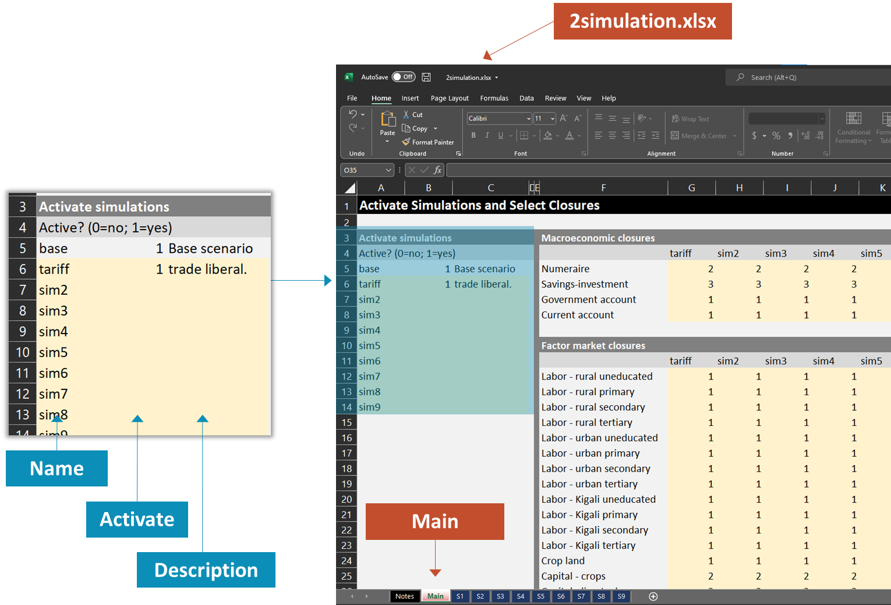
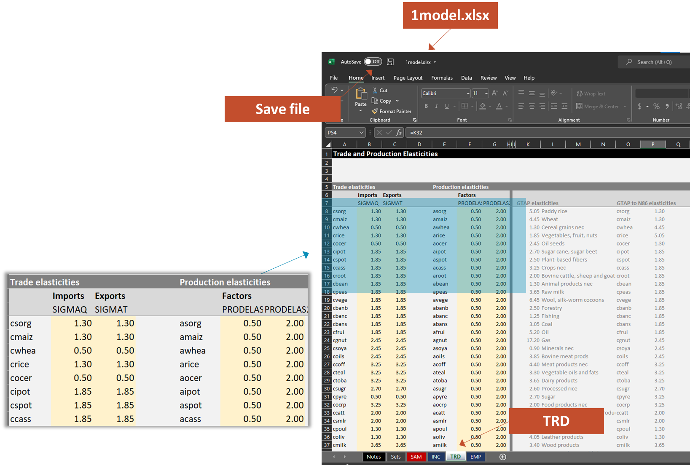
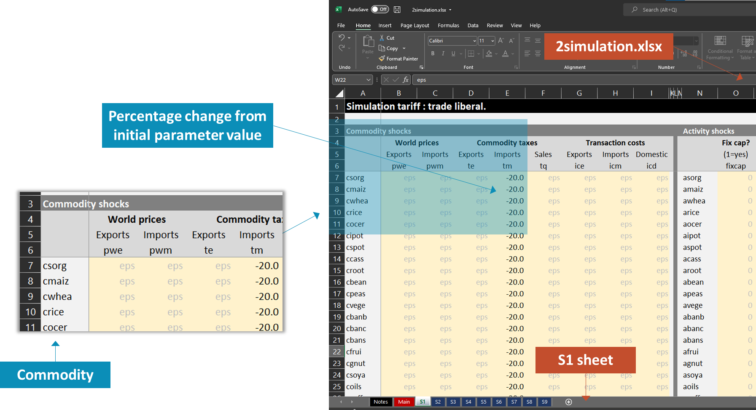
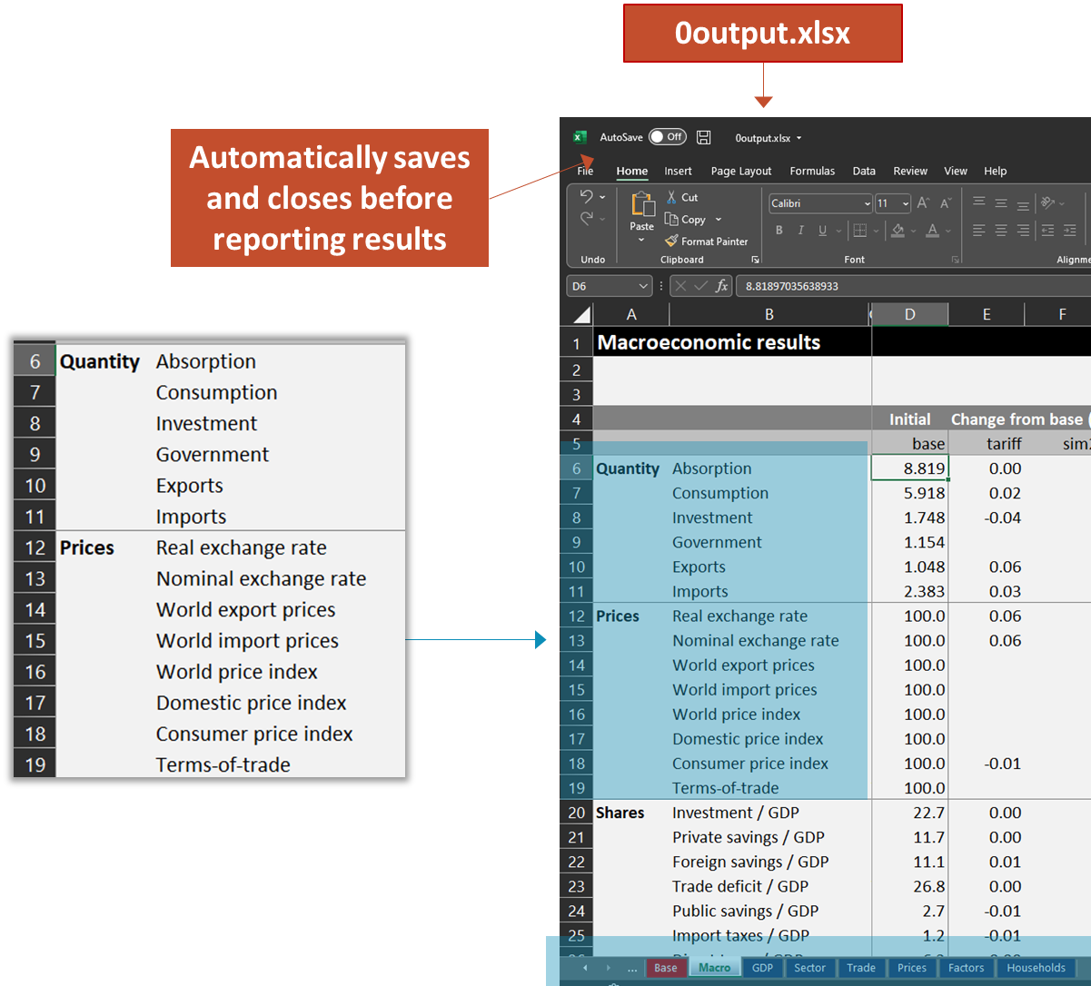
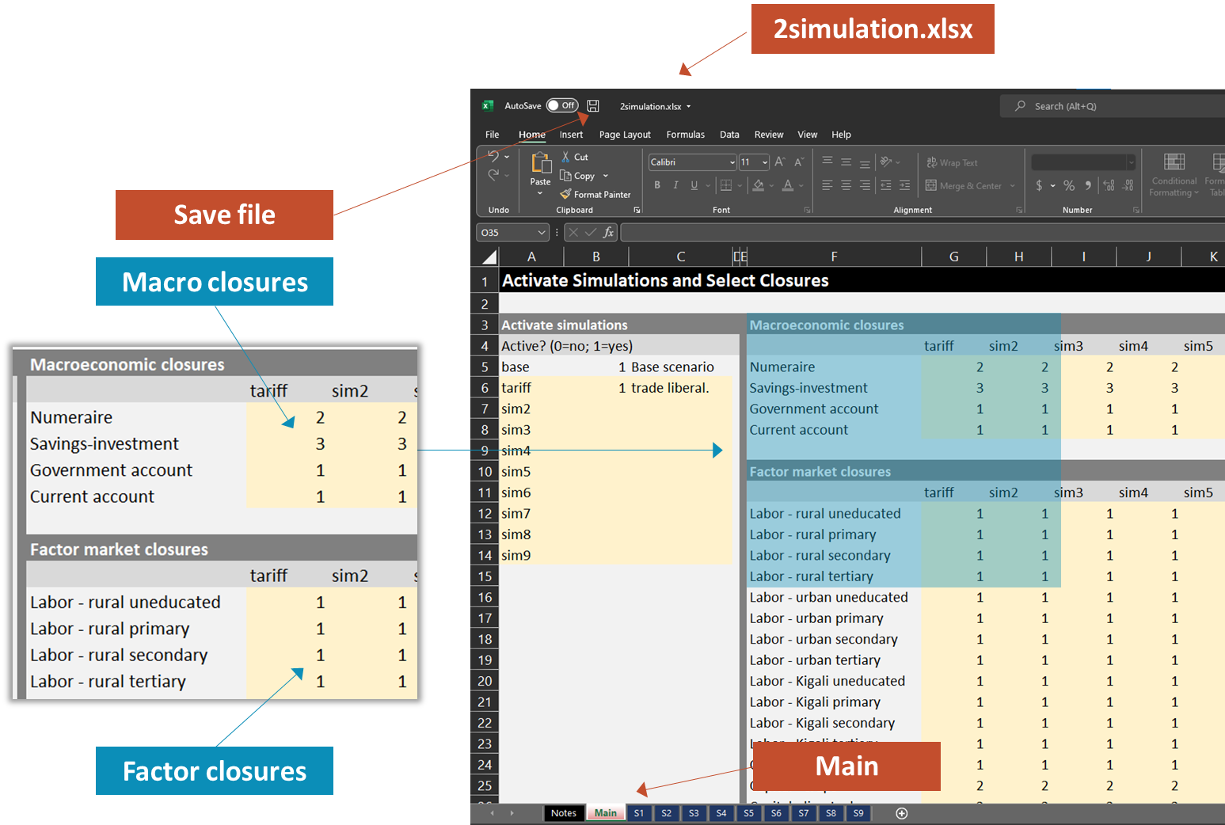
Five Steps to Running the Model
Step 1 Name & activate simulations
1
2
Model interface
1model.xlsx
Model code
1model.gms
Data SAM, elasticities
4
3
Step 2 Impose shocks
Simulation code
2simulation.gms
Simulation interface 2simulation.xlsx
5
Results interface
0output.xlsx
Results Macro, household, etc.
Step 3 Select closures

Slide 14
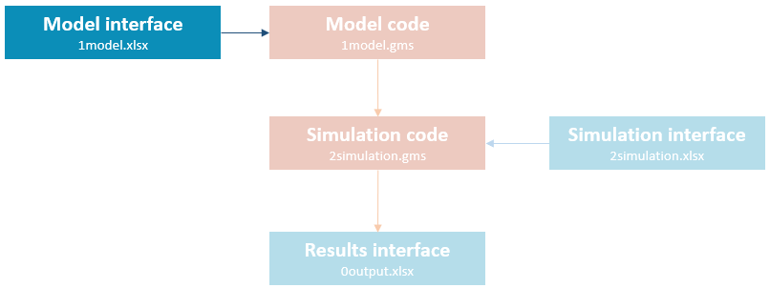
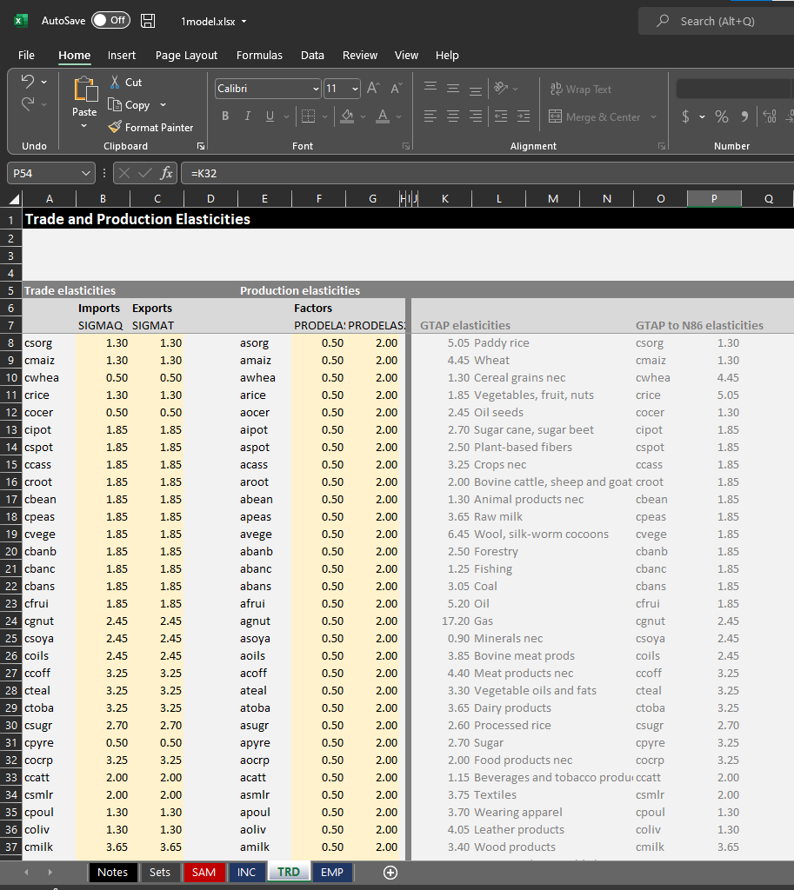
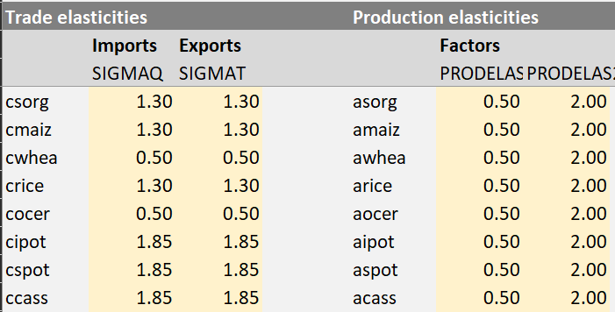
Step 1 | Changing Elasticities (Optional)
1model.xlsx
Save file
TRD
1national.xlsx | TRD

Slide 15
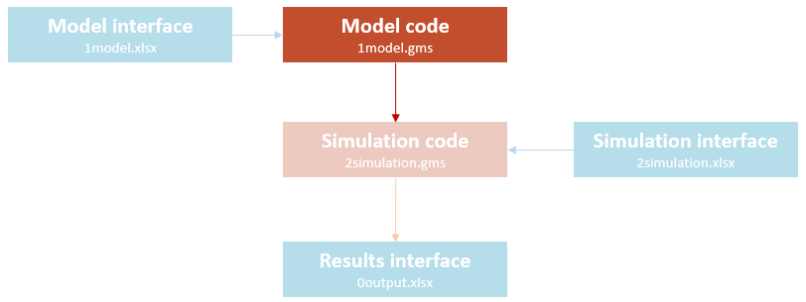
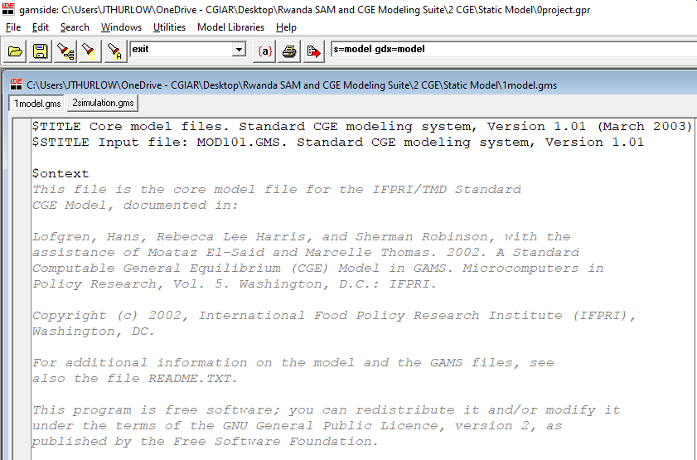
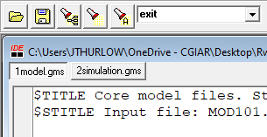
Step 2 | Initializing Model (Push F9)
Press F9
Check project and model files are in the same folder
1model.gms

Slide 16
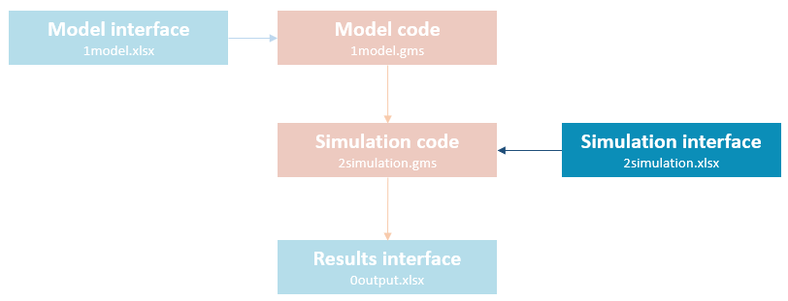
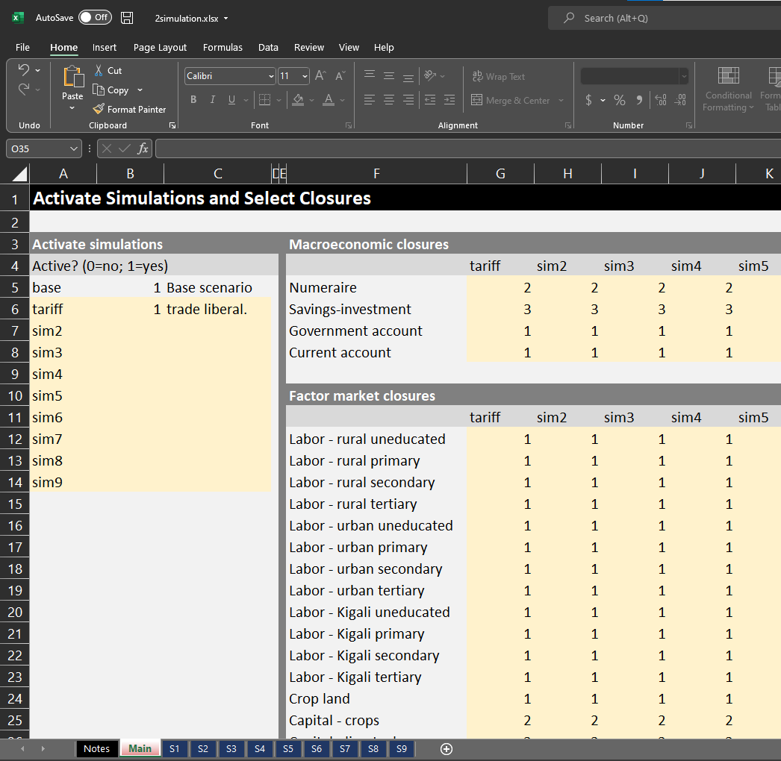
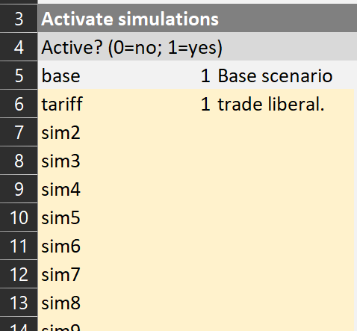
Step 3 | Designing Simulations (Part 1)
2simulation.xlsx
Naming and activating simulations
Name
Activate
Main
Description

Slide 17
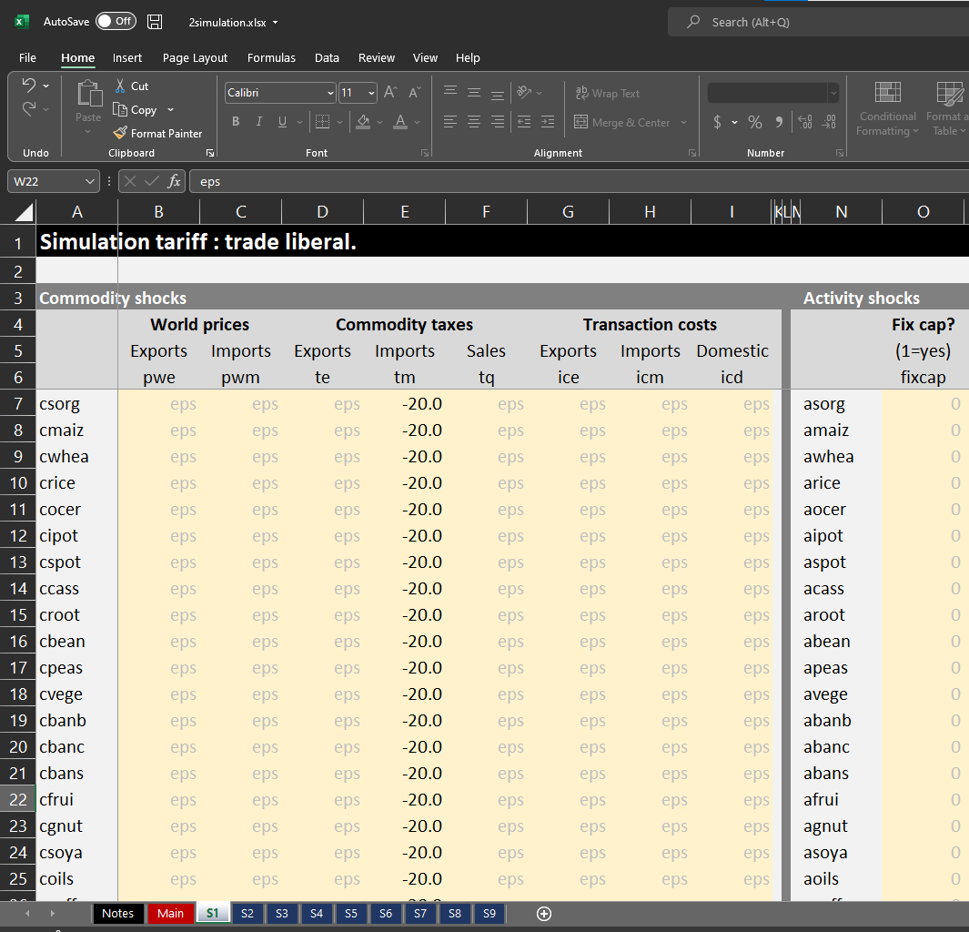
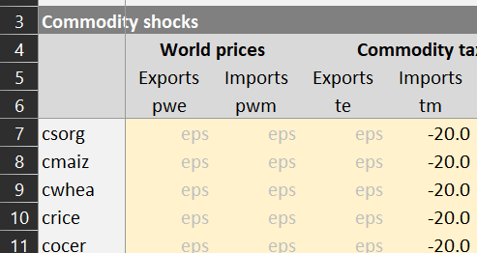
Step 3 | Designing Simulations (Part 2)
Imposing shocks
2simulation.xlsx
Percentage change from initial parameter value
S1 sheet
Commodity

Slide 18
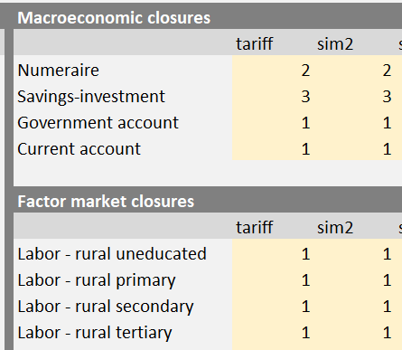
Step 3 | Designing Simulations (Part 3)
2simulation.xlsx
Selecting macro and factor closures
Save file
Macro closures
Factor closures
Main

Slide 19
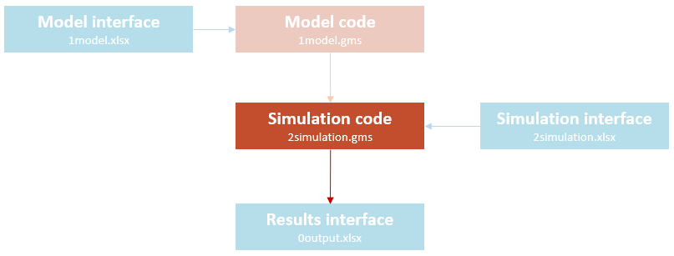
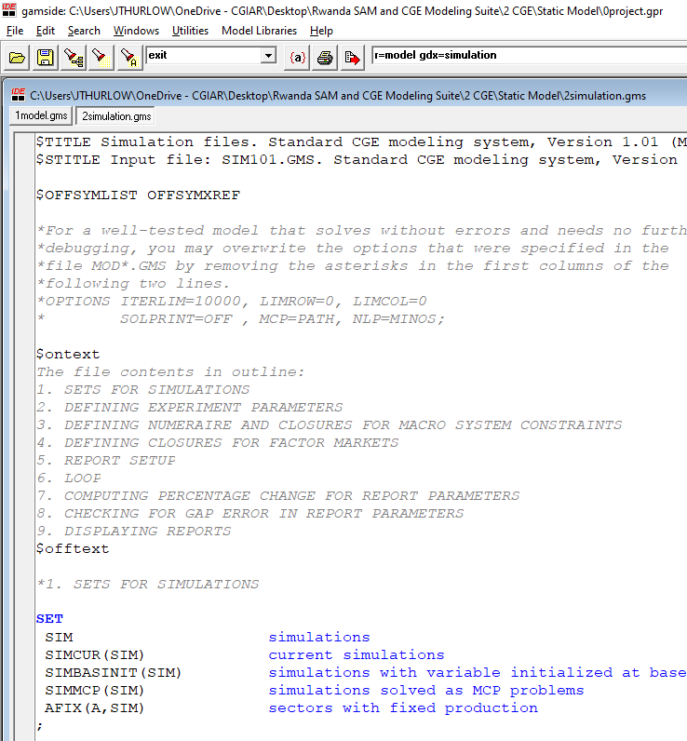
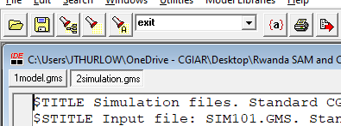
Step 4 | Running Simulations (Push F9)
2simulation.gms
Press F9

Slide 20
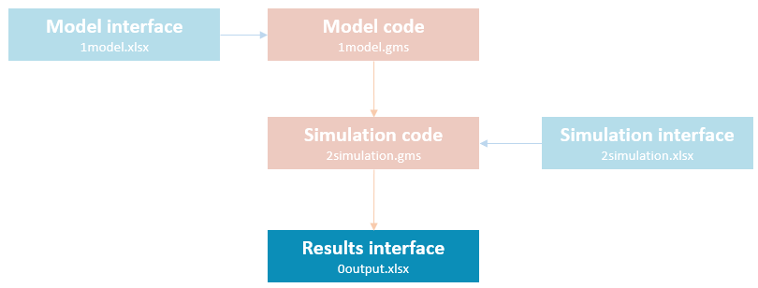
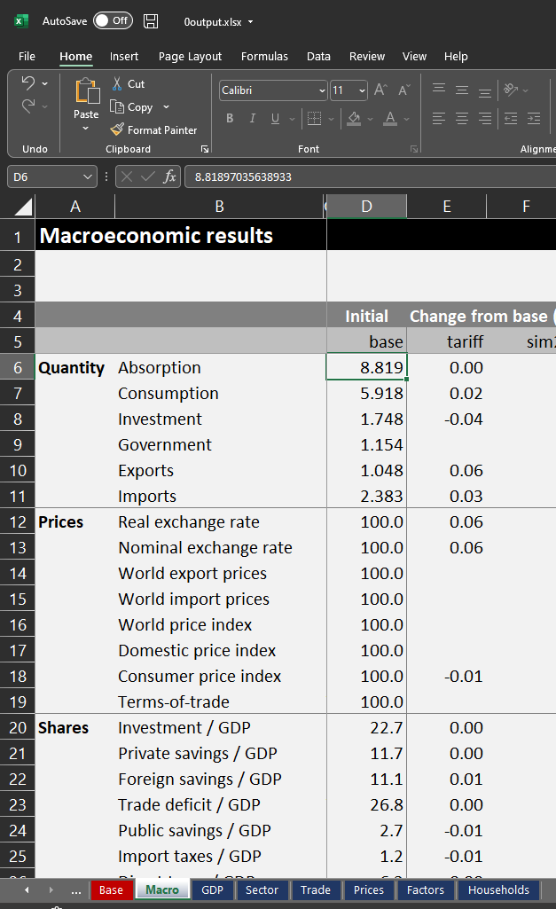
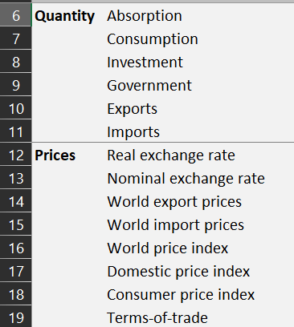
Step 5 | Reviewing Simulation Results
0output.xlsx
Automatically saves and closes before reporting results

Slide 21
Step 5 | Reviewing Simulation Results
Worksheet | Tables
Base | Initial sectoral production, trade and tax structure
Macro | Macroeconomic results, including exchange rates and CPI
GDP | GDP by expenditure group (nominal and real)
Sector | Sectoral GDP at factor cost
Trade | Real value of imports and exports
Prices | Producer, market and world prices
Factors | Total factor supply, economy-wide returns, total factor incomes, and sectoral factor demand
Households | Institutional incomes, equivalent variation (welfare), real expenditure by commodity, and institutional tax rates and collections

Slide 22
Activity 1.3 Rwanda CGE Model and Excel Interface Using GDX to import and export data via Excel

Slide 23
GDX | GAMS Data Exchange
1
2
Model interface
1model.xlsx
GDX
1model.gdx
Model code
1model.gms
4
3
Simulation code
2simulation.gms
GDX
2simulation.gdx
Simulation interface 2simulation.xlsx
GDX
0output.gdx
5
Results interface
0output.xlsx

Slide 24
GDX | Importing Data from Excel
1
2
Model interface
1model.xlsx
GDX
1model.gdx
Model code
1model.gms
Pull data from Excel into the GDX file
Call GDXXRW facility
Identify Excel file
Identify index containing worksheets/cell locations of data
$call "gdxxrw i=1model.xlsx index=index!a7"
$gdxin model.gdx
Load data into GAMS from GDX file
Identify sets, parameters, etc. stored in the GDX
$load AC A …

Slide 25
GDX | Exporting Data to Excel
4
Unload data into GDX file from GAMS
Identify sets, parameters, etc. stored in the GDX
Simulation code
2simulation.gms
execute_unload "0output.gdx" TAXTAB STRUCBASE2 …
GDX
0output.gdx
5
Push data from GDX file into Excel
Call GDXXRW facility
Identify Excel file
Identify index with worksheets/cell locations where data is to be stored
Results interface
0output.xlsx
execute 'gdxxrw.exe i=0output.gdx o=0output.xlsx index=index!g6'

Slide 26
GDX | Other GDX Commands
XLSTALK allows you to check on status of an Excel and execute commands to Excel
M: Check status of an Excel file (0 = not open | 1 = open but not modified | 2 = open and modified)
execute 'xlstalk.exe -m 0output.xlsx’
Create a parameter (e.g., XLTEST) and assign it the value ERRORLEVEL (e.g., XLTEST = ERRORLEVEL)
C: Close an open Excel file, but do not save changes
execute 'xlstalk.exe -c 0output.xlsx’
S: Save and then close an open Excel file
execute 'xlstalk.exe -s 0output.xlsx’
O: Open an Excel file
execute 'xlstalk.exe -o 0output.xlsx’

Slide 27
GDX | Exercises
Example 1: Importing and exporting using an Excel Index
Load two sets and a parameter from Excel
Transpose the parameter and calculate row/column totals
Export back to Excel
Example 2: Mapping two sets in Excel
Load three sets and a detailed parameter from Excel
Aggregate detailed parameter
Transpose the parameter and calculate row/column totals
Export back to Excel
Exercise: Hands-on with GDX
Load in a detailed SAM sets and data
Aggregate SAM
Export back to Excel

Slide 28
Activity 2 Using the Interface Walkthrough of foreign savings scenario

Slide 29
Simulation | Foreign Capital Inflows
Shock
Lower foreign capital inflows (i.e., -10% foreign savings)
Three sets of closures
Sim1: Full employment, savings-driven investment (fixed savings rates, flexible investment)
Sim2: Full employment, investment-driven savings (fixed investment, flexible savings rates)
Sim3: Unemployment, investment-driven savings (fixed wage rate, flexible labor supply)
Current account
Total inflow of foreign exchange (exports, grants and remittances) must equal total outflows (imports)
Fix one
Exchange rate
Foreign savings
Exports
+
Grants
+
Remittances
+
Foreign saving
=
Imports
Savings – Investment
Total supply of loanable funds (savings) must equal total investment demand
Fix one
Savings rates
Investment
Private saving
+
Public saving
+
Foreign saving
=
Investment

Slide 30
Walkthrough | Foreign Capital Inflows
Macro
↓Foreign savings = Exchange shortage → Real exchange rate depreciation → ↑Exports & ↓Imports
↓Foreign savings = ↓Loanable funds → ↓Investment OR ↑Private savings
↑Private savings → ↓Private consumption
Trade (+ Base)
Depreciation → ↑Export-oriented commodities (e.g., coffee) & ↓Import-intensive (e.g., pharma)
Sector
↓Investment → ↓Construction (i.e., stone, sand, etc.)
↓Private consumption → ↓Food (e.g., crops, livestock, etc.)
Factors
↓Wages OR ↓Employment (larger ↓wage with ↓construction, which is capital-intensive)
Households
↓Private consumption (larger with ↑private savings & unemployment)
Poor rural households are least-affected because of export agriculture growth

Slide 31
Simulation | Tariff Liberalization
Shock
Eliminate all tariffs (i.e., -100%)
Two sets of closures
Sim1: Unemployment, investment-driven savings, deficit financed (fixed investment, flexible savings rates, flexible government savings)
Sim2: Unemployment, investment-driven savings, tax financed (fixed investment, flexible savings rates, flexible direct tax rates)
Government
Recurrent fiscal deficit (savings) equals total revenues (taxes and grants) less total expenditures (consumption and transfers)
Fix two
Tax rates
Consumption
Public savings
Direct taxes
+
Indirect taxes
+
Grants
=
Consumption
+
Transfers
+
Public saving
Savings – Investment
Total supply of loanable funds (savings) must equal total investment demand
Fix one
Savings rates
Investment
Private saving
+
Public saving
+
Foreign saving
=
Investment

Slide 32
Walkthrough | Tariff Liberalization
Macro
↓Tariffs → ↑Imports → Real exchange rate depreciation → ↓Exports
↓Tariffs → ↓Consumer prices → ↑Private consumption
↓Tariffs = Revenue shortfall → ↓Public savings OR ↑Tax rates
↓Public savings → ↓Investment
↑Tax rates → Smaller ↓private consumption
Trade (+ Base)
↓Tariffs → ↑Import-intensive commodities (e.g., rice, grain milling, but not wheat – no tariff in base)
Sector
↓Tariffs → ↓GDP for import-competing sectors (e.g., rice, but growth in wheat)
Households
↑Private consumption
↑Tax rates → ↓Consumption for high-income households (higher initial tax rates)

Slide 33
Global Crisis
Part 1: Higher world prices
Apply to both world import and export prices, and to raw and processed products
Stylized shocks
Maize +10%
Wheat +50%
Edible oils + 25%
Crude oil + 20%
Natural gas +25%
Fertilizer + 50% (need to weight shock)
Part 2: Reduced fertilizer use?
Reduce food crop productivity by 2.5%
Part 3: Combine parts 1 and 2
Part 4: Policy responses?
Closure choices?

Slide 34

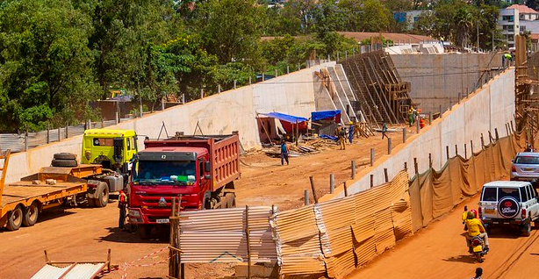


CHOGM
Part 1: Production gains for actual event
Hotels, travel, restaurants
Part 2: Preparation benefits
Investment and construction spending
Transport system productivity
Part 3: Combine parts 1 and 2

